Slide 1

SQL and Java
The vision for Java is to be the concrete and nails that people use to build this incredible network system that is happening all around us
James Gosling, 2000
Notes:
http://www.infoworld.com/articles/hn/xml/00/10/09/001009hnjg.html

Slide 2
Development with Java
Java is a platform-independent object-oriented development language
A simple approach to the development, management,and deployment of client/server and browser applications

Slide 3
JDBC
Java database connectivity (JDBC) is modeled on ODBC
Enables development of applications that are OS and DBMS independent

Slide 4
JDBC
Application
JDBC API
JDBC driver manager
Service provider API
Driver for DBMS server
DBMS server

Slide 5
JDBC
JDBC has seven interfaces and two classes
Interfaces need to be written for a specific DBMS
A driver must be installed before you can access a specific DBMS
  servlet.java.sun.com/products/jdbc/drivers

Slide 6
Loading the driver
Class.forName(driver);
No parameters

Slide 7
Loading the driver
public void loadDriver(String driver) {
try {
Class.forName(driver);
}
catch (ClassNotFoundException error) {
System.out.println("Could not load driver: " + error.toString());
System.exit(1);
}
}

Slide 8
Connecting to the DBMS
Supply the
  url
  login id
  password
Format of the url varies with the driver
  jdbc:mysql://www.richardtwatson.com:3306/text

Slide 9
Connecting to the DBMS
public void connectDatabase(String db, String user, String password) {
try {
dbConnect = DriverManager.getConnection(db, user, password);
}
catch(SQLException error) {
System.err.println("Error connecting to database: " + error.toString());
System.exit(2);
}
}

Slide 10
Create an SQL statement
Create a statement object
  createStatement invokes a statement object
Execute the query
  executeQuery(sql string)
Results are returned in a ResultSet object

Slide 11
Create an SQL statement
public void createSQL() {
try {
dbStatement = dbConnect.createStatement();
}
catch(SQLException error) {
System.err.println("Error creating statement: " + error.toString());
System.exit(3);
}
}

Slide 12
Execute a SELECT
Create a statement object
  createStatement invokes a statement object

Slide 13
Execute a SELECT
public void executeSQL(String query) {
try {
System.out.println(query + "\n");
dbResultSet = dbStatement.executeQuery(query);
}
catch(SQLException error) {
System.err.println("Error executing SQL: " + error.toString());
System.exit(4);
}
}

Slide 14
Report a SELECT
The rows in the table are processed a row at a time using the next method of the ResultSet object
Columns are retrieved one at a time using a getString

Slide 15
Report a SELECT
public void reportSQL() {
int i;
try {
dbResultSetMetaData = dbResultSet.getMetaData();
// Get the number of columns in the result set
int numCols = dbResultSetMetaData.getColumnCount();
// Fetch until end of the result set
while (dbResultSet.next()) {
// Loop through each column
for (i=1; i<=numCols; i++) {
if (i > 1) System.out.print(" ");
System.out.print(dbResultSet.getString(i));
System.out.println("");
}
}
catch(SQLException error) {
System.err.println("Error displaying results: " + error.toString());
System.exit(5);
}
}

Slide 16
Process the table

Slide 17
Reporting
public void reportSQL() {
int i;
try {
dbResultSetMetaData = dbResultSet.getMetaData();
// Get the number of columns in the result set
int numCols = dbResultSetMetaData.getColumnCount();
// Fetch until end of the result set
while (dbResultSet.next()) {
// Loop through each column
for (i=1; i<=numCols; i++) {
if (i > 1) System.out.print(" ");
System.out.print(dbResultSet.getString(i));
System.out.println("");
}
}
catch(SQLException error) {
System.err.println("Error displaying results: " + error.toString());
System.exit(4);
}
}

Slide 18
Inserting a row
executeUpdate(sql string)
public void insertSQL(String sql){ {
try {
dbStatement = dbConnect.createStatement();
int result = dbStatement.executeUpdate(sql);
}
catch(SQLException error) {
System.err.println("Error inserting row: " + error.toString());
System.exit(5);
}
}

Slide 19
Closing the connection
public void closeDatabase() {
try {
dbResultSet.close();
dbStatement.close();
dbConnect.close();
}
catch(SQLException error) {
System.err.println("Error closing: " + error.toString());
System.exit(6);
}
}

Slide 20
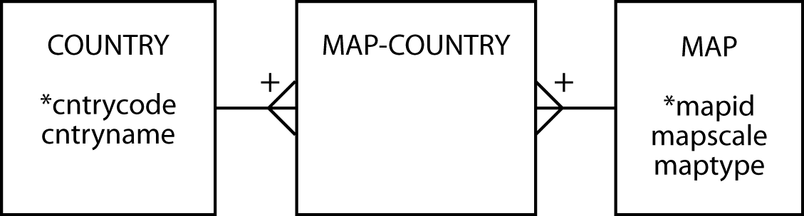
Map collection case

Slide 21
Data entry

Slide 22
Numeric validation
dataOK = true;
try {
mapId = Integer.parseInt(jTextField2.getText());
}
catch(NumberFormatException error) {
System.err.println("Map identifier not an integer");
dataOK = false;
}
try {
mapScale = Integer.parseInt(jTextField1.getText());
}
catch(NumberFormatException error) {
System.err.println("Map scale not an integer");
dataOK = false;
}
if (! dataOK) {
return;
}

Slide 23
Transaction processing
A transaction is a logical unit of work
  Insert one row in map
  Insert one row in MAP-COUNTRY for each country on the map
All inserts must complete successfully for the transaction to be processed
COMMIT
  Transaction successful
ROLLBACK
  Transaction failure

Slide 24
AUTOCOMMIT
Turn off autocommit to enable COMMIT and ROLLBACK
public void autoCommit(boolean commit){
try {
dbConnect.setAutoCommit(false);
}
catch (SQLException error){
System.out.println("Could not turn off autocommit");
System.exit(1);
}
}

Slide 25
COMMIT
public void dbCommit(){
try {
dbConnect.commit();
System.out.println("Transaction commit");
}
catch (SQLException error){
System.out.println("Could not commit");
System.exit(1);
}
}

Slide 26
ROLLBACK
public void dbRollback(){
try {
dbConnect.rollback();
System.out.println("Transaction rollback");
}
catch (SQLException error){
System.out.println("Could not rollback");
System.exit(1);
}
}

Slide 27
Inserting a map
mapType = mapList.getSelectedValue().toString();
sql = "insert into map values (” +
+ mapId + "," + mapScale + "," + "'" + mapType + "')";
try {
dbStatement = dbConnect.createStatement();
int result = dbStatement.executeUpdate(sql);
}
catch(SQLException error) {
System.err.println("Error inserting row: " + error.toString());
transOK = false;
}

Slide 28
Inserting countries
selectedIndices = nationList.getSelectedIndices();
i = selectedIndices.length;
for (j = 0; j < i; j++ ){
natCode = nationCode[selectedIndices[j]];
sql = "insert into mapCountry values (" + mapId + "," + "'" + natCode + "')";
try {
dbStatement = dbConnect.createStatement();
int result = dbStatement.executeUpdate(sql);
}
catch(SQLException error) {
System.err.println("Error inserting row: " + error.toString());
transOK = false;
}
}

Slide 29
Completing the transaction
if (transOK) {
dbCommit();//all inserts successful
}
else {
dbRollback(); //at least one insert failed
}

Slide 30
Putting the program together
Code pieces are embedded in event handler invoked when “Add map” is clicked

Slide 31
Program structure
private void jButton1MouseClicked(java.awt.event.MouseEvent evt) {
int mapId, mapScale;
int[] selectedIndices;
String sql, mapType, natCode;
String nationCode[] = {"at","be","fr","de","nl","sh"};
boolean transOK, dataOK;
mapId = 0; // initialize
mapScale = 0; // initialize
transOK = true; // initialize
dataOK = true; // initialize
// check mapId is integer
…
// check mapScale is integer
…
// errors for mapId or mapScale?
…
// insert a map
…
// insert countries on map
…
// commit or rollback?
…
}

Slide 32
Key points
Java can be used to developed interoperable multi-tier applications
JDBC is the key technology for accessing a relational database
Java is well-suited for processing transactions that amend a relational database

